Slide 1
Note 8
ER to Relational Mapping
CSC134
Dr. Haiquan Chen

Slide 2
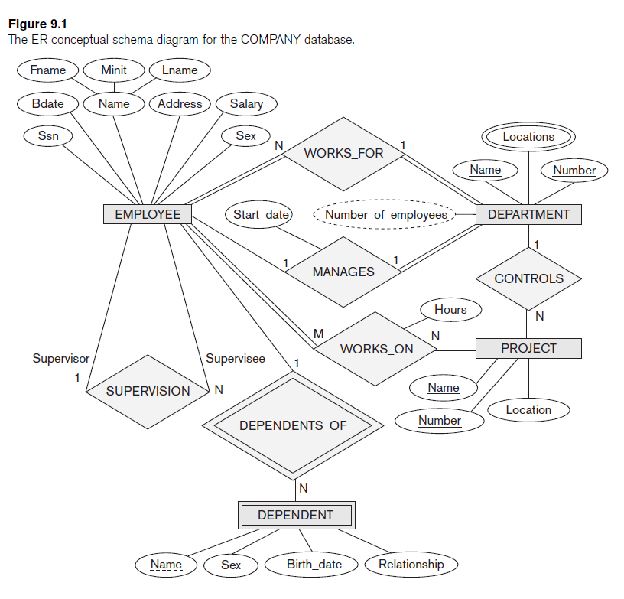

Slide 3
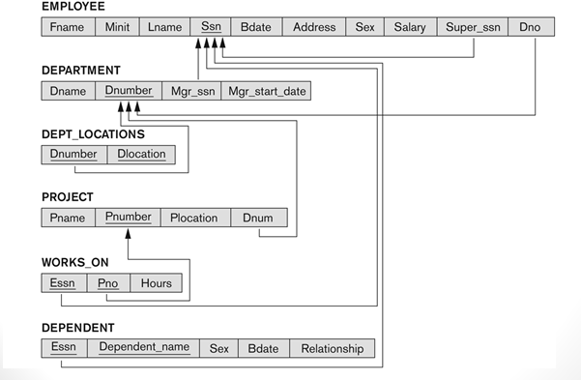

Slide 4
GOALS during Mapping
Preserve all information (that includes all attributes)
Maintain the constraints (key, cardinality) as mush as possible
Minimize null values in the resulting relational schema

Slide 5
Mapping Outline
ER-to-Relational Mapping Algorithm
  Step 1: Mapping of Regular Entity Types
  Step 2: Mapping of Weak Entity Types
  Step 3: Mapping of Binary 1:1 Relation Types
  Step 4: Mapping of Binary 1:N Relationship Types.
  Step 5: Mapping of Binary M:N Relationship Types.
  Step 6: Mapping of Multivalued attributes.
  Step 7: Mapping of N-ary Relationship Types.

Slide 6
ER-to-Relational Mapping Algorithm
Step 1: Map Regular (non-weak) Entity Types
  For each regular entity type E, create a relation R that includes all the atomic attributes of E
  As for a composite attribute, include only its atomic component attributes
  Choose one of the key attributes of E as the PK for R

Slide 7
ER-to-Relational Mapping

Slide 8
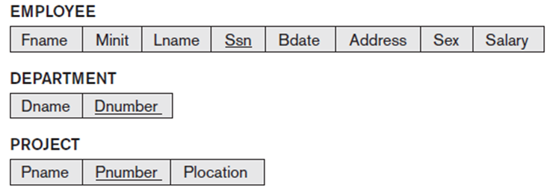

Slide 9
ER-to-Relational Mapping Algorithm (cont’d.)
Step 2: Map Weak Entity Types
  For each weak entity type W, create a relation R and include all atomic attributes of W as attributes of R
  Add PK of owner entity type as FK of R
  The PK of R is the combination of the PK of owner entity type and the partial key attribute of W

Slide 11



Slide 12
ER-to-Relational Mapping Algorithm (cont’d.)
Step 3: Mapp Binary 1:1 Relationship Types
  For each binary 1:1 relationship type R
    Identify the participating entity types, let’s say S and T
    Add the PK of T as a FK of S or Add the PK of S as a FK of T
    Include all the atomic attributes of R

Slide 14


Slide 15
ER-to-Relational Mapping Algorithm (cont’d.)
Step 4: Map Binary 1:N Relationship Types
  For each binary 1:N relationship type R
    Identify the 1-side entity type, let’s say T
    Add the PK of T as FK in S
    Include all atomic attributes of R as attributes of S

Slide 17




Slide 18
ER-to-Relational Mapping Algorithm (cont’d.)
Step 5: Map Binary M:N Relationship Types
  For each binary M:N relationship type R
    Create a new separate relation S
    Add PK’s of both-sides entity types as foreign key in S
    The combination of the two PK’s will form the PK of S
    Include all atomic attributes of R as attributes of S

Slide 20



Slide 21
ER-to-Relational Mapping Algorithm (cont’d.)
Step 6: Map Multivalued Attributes
  For each multivalued attribute A
    Create a new relation R
    The combination of A and PK of the relation forms PK of R
    If the multivalued attribute is composite, add its atomic components as attributes of R

Slide 23


Slide 24
The final resulting DB schema

Slide 25
ER-to-Relational Mapping Algorithm (cont’d.)
Step 7: Map N-ary Relationship Types (n>2)
  For each n-ary relationship type R
    Create a new relation S
    Add PKs of all participating entity types as foreign keys
    The PK of S is the combination of those foreign keys (excluding those for the 1-side entity types)
    Include all atomic attributes as attributes of S

Slide 26
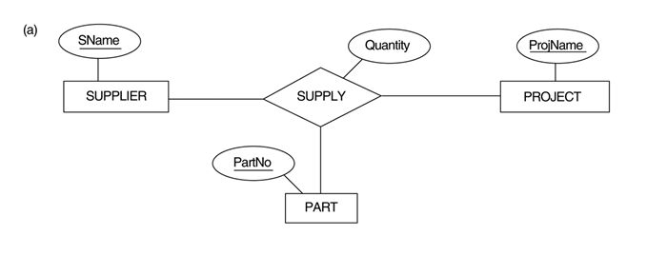
Example ER diagram

Slide 27
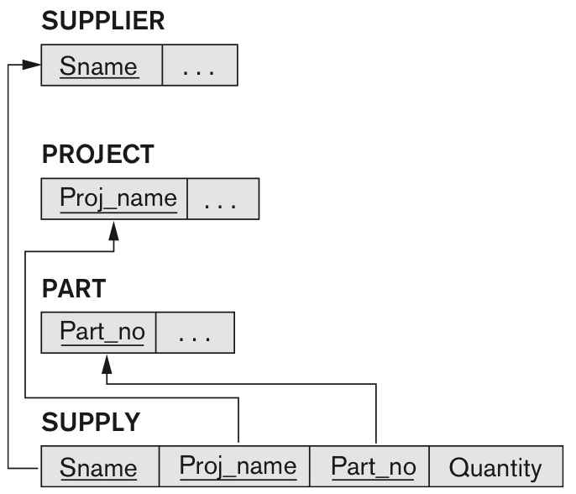
Schema

